Slide 1
EAI Demo

Slide 2
Our Product
Explains Transparency and Fairness
Our product aims at simplifying interpretations by providing explanations about predictions made by a ML model both a local and global level.
Additionally, it also check for fairness of the data and model by quantifying bias associated with any sensitive variable such as gender, caste, ethnicity, etc.

Slide 3
Model coverage
Different types of models are supported by our tool :
Types of model
For now our tool will only support sk-learn models
1. Classification
2. Regression
Tree Methods | Linear methods | Kernel Methods
Random Forest | Linear Regression | SVM
CatBoost | ElasticNet | KNN
XGBoost | BayesRidge
GBM & LGBM | Logistic regression
Different Algorithmic methods
All Tree Methods
Linear Methods
Kernel Methods
Deep Neural Networks*
* Work in progress
Note: Our fairness module does not require model. So, it’s a model independent approach.

Slide 4
FAIRNESS

Slide 5

What is Fairness Measurement ?
Assessing Fairness means that segments of sensitive variables within training data and new unseen data are expected to be treated equally*(ideal condition) in terms of accuracy, selectivity, opportunity.
Apple's Titanium Credit Card serves a good example.
The algorithm at the backend assesses an individuals credit worthiness taking into account factors such as personal credit scores and personal debt.
It was observed that men received higher credit limits than women – a case of unfair model.

Slide 6

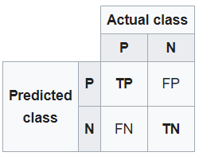
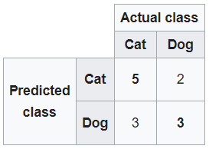
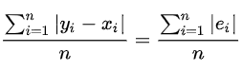
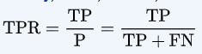
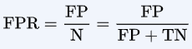
How to measure Fairness ?
Statistical Parity difference(Fairness at Data Level) :
Fairness at pre modeling stage
Computed as the difference of the rate of favorable outcomes received by the unprivileged group to the privileged group.
The ideal value is 0.
A value of < 0 implies higher benefit for the privileged group and a value > 0 implies higher benefit for the unprivileged group.
𝑃𝑟(𝑌=1|𝐷=𝑢𝑛𝑝𝑟𝑖𝑣𝑖𝑙𝑒𝑔𝑒𝑑)−𝑃𝑟(𝑌=1|𝐷=𝑝𝑟𝑖𝑣𝑖𝑙𝑒𝑔𝑒𝑑)
Average Absolute Odds Difference (Fairness at Model Level) :
Fairness at post modeling stage
Computed as average difference of false positive rate and true positive rate between unprivileged and privileged groups.
The ideal value is 0.
(1/2[|𝐹𝑃𝑅𝐷=𝑢𝑛𝑝𝑟𝑖𝑣𝑖𝑙𝑒𝑔𝑒𝑑−𝐹𝑃𝑅𝐷=𝑝𝑟𝑖𝑣𝑖𝑙𝑒𝑔𝑒𝑑|+|𝑇𝑃𝑅𝐷=𝑢𝑛𝑝𝑟𝑖𝑣𝑖𝑙𝑒𝑔𝑒𝑑−𝑇𝑃𝑅𝐷=𝑝𝑟𝑖𝑣𝑖𝑙𝑒𝑔𝑒𝑑|])
Mean Absolute Error :
Absolute average of the fairness measures at data and model level
The fairness result is decided using this measure based on the given threshold

Slide 7
TRANSPARENCY

Slide 8
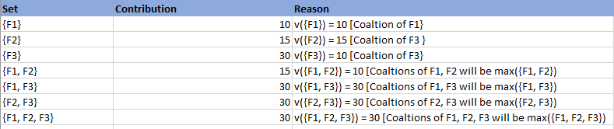
What is Transparency ?
To get a fair idea about the calculation of Shapley Value, let’s think of a simple example.
Three friends F1, F2, and F3 are going to share the taxi to reach their home. If they go individually then each needs to pay $10, $15, and $30 respectively.
If they travel in a group then the maximum payment will be $30. But the question is — Apart from the general average pay contribution [(10+15+30)/3], how can we calculate fair individual pay from a coalition?
However, if they are going to travel together then below combination will be formed

Slide 9
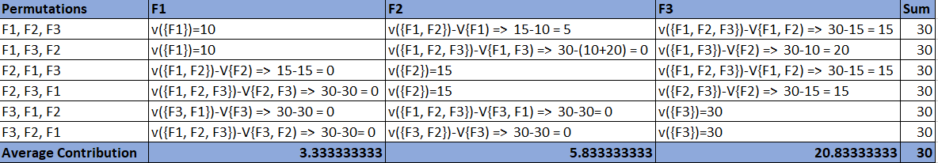
Now, let’s create a possible permutation if they travel in a group with given coalitions.
The calculated averages are Shapley value which gives individuals pay for all friends if they travel together. And if we sum up the average value of all friends and coalition pay of the permutation set then it always ends up with 30 which shows the payments are fairly distributed.
In machine learning, we can relate above understanding ike this.
Game -> Model
Players -> Features
Subset of Players -> Subset of Features
Shapley value of Features -> contribution of the feature.

Slide 10
Explainable AI with Shapley Values

Slide 11
Why was I denied?
Accuracy = $
chance John will have repayment problems
model
22%
No loan
What is our
financial risk?
How do I
debug?
John, a bank customer
Notes:
We'll start with a simple motivational example. This is John, a typical bank customer. Like many consumers today, when he applies for a loan, information about him is sent through a predictive model XX.
This model is designed to calculate the risk that John will have repayment problems, XX which, unfortunately for John, is 55%. And because his risk is high, the bank declines his loan application XX.
A natural first question John has XX is “Why?” The bank XX also want to know why, because these are key business decisions. But unfortunately for the data scientist that built this model XX, she used a complex model and so these questions are hard to answer XX …. XX

Slide 12
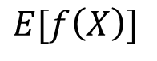
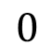
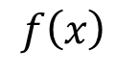
Base rate
Prediction for John
16%
22%
$$0$$
$$E[f\left(X\right)]$$
$$f\left(x\right)$$
How did we get here?
Notes:
To see, let’s return to John and answer why his loan application was denied. To explain his denial it is important to start with the base rate of loan repayment problems XX, denoted here by the expected value of the model’s output.
To explain John's risk XX, we need to explain how we got from the base rate XX, to his risk of 55%. XX

Slide 13
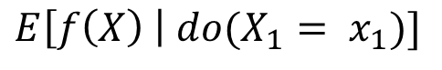
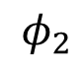
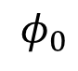
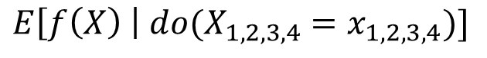
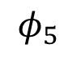
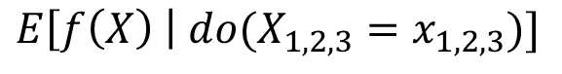
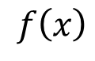
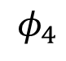
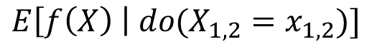
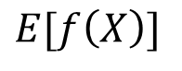
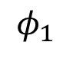
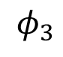
The order matters!
16%
18.2%
18.5%
21%
22%
22.5%
$$E[f\left(X\right)]$$
*
$$E\left[f\left(X\right) \right| {do(X}_{1,2,3}=x_{1,2,3})]$$
$$f\left(x\right)$$
$$E\left[f\left(X\right) \right| do(X_{1}= x_{1})]$$
$$E\left[f\left(X\right) \right| do(X_{1,2}=x_{1,2})]$$
$$0$$
$$E\left[f\left(X\right) \right| do(X_{1,2,3,4}=x_{1,2,3,4})]$$
$$φ_{0}$$
$$φ_{2}$$
$$φ_{1}$$
$$φ_{4}$$
$$φ_{3}$$
Base rate
DTI = 30
Income not verified
Delinquent 10 months ago
No recent account openings
$$φ_{5}$$
*Janzing et al. 2019
46 years of credit history
Notes:
To see, let’s return to John and answer why his loan application was denied. To explain his denial it is important to start with the base rate of loan repayment problems XX, denoted here by the expected value of the model’s output.
To explain John's risk XX, we need to explain how we got from the base rate XX, to his risk of 55%. XX

Slide 14
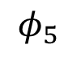
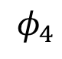
Lloyd Shapley
The order matters!
Nobel Prize in 2012
$$0$$
$$E[f\left(X\right)]$$
$$f\left(x\right)$$
$$φ_{0}$$
$$φ_{2}$$
$$φ_{1}$$
$$φ_{3}$$
$$φ_{5}$$
46 years of credit history
$$φ_{4}$$
No recent account openings
Notes:
To see, let’s return to John and answer why his loan application was denied. To explain his denial it is important to start with the base rate of loan repayment problems XX, denoted here by the expected value of the model’s output.
To explain John's risk XX, we need to explain how we got from the base rate XX, to his risk of 55%. XX

Slide 15
Shapley values result from averaging over all N! possible orderings.
(NP-hard)
$$0$$
$$E[f\left(X\right)]$$
$$f\left(x\right)$$
$$φ_{0}$$
$$φ_{2}$$
$$φ_{1}$$
$$φ_{3}$$
$$φ_{5}$$
$$φ_{4}$$
Notes:
To see, let’s return to John and answer why his loan application was denied. To explain his denial it is important to start with the base rate of loan repayment problems XX, denoted here by the expected value of the model’s output.
To explain John's risk XX, we need to explain how we got from the base rate XX, to his risk of 55%. XX

